Slide 1

King County Housing
Rachel Beery with the Flatiron Data Science Program

Slide 2
Presentation Goals
We are working to see what features a house has to increase profits on the housing market in King County, Washington..
All recommendations given are ways in which the home owner can change their home to increase their home’s value

Slide 3
Data
Data was provided by the King County, Washington government.
Housing data provided is from house sold between 2014 and 2015.
Prices of the homes sold range from $0 to $1,000,000.

Slide 4
Recommendations
Add more bathrooms to the Home
Increase the Grade of the Home
Add more bedrooms to the Home
Increase the square footage living space of the Home
Improve the Condition of the Home

Slide 5
Grade of the Home
1

Slide 6
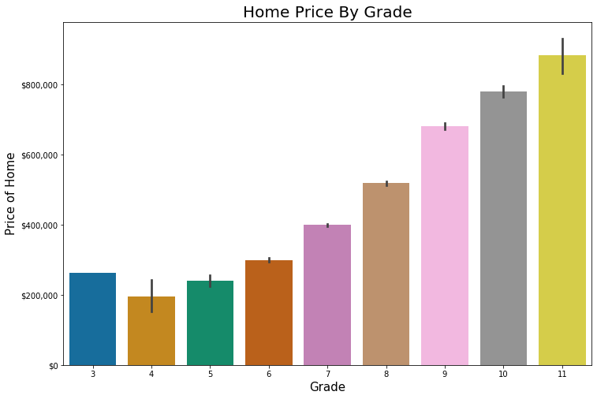
By increasing the “Grade” of the home the home’s value steadily increases
Grade is based on the home’s building materials, construction quality, and square footage

Slide 7
Bedrooms
2

Slide 8
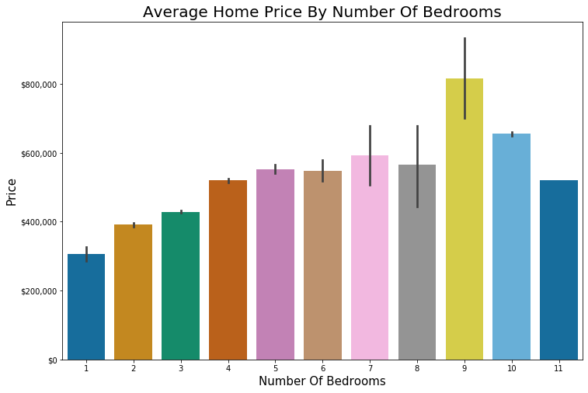
Homes with more bedrooms have a shown higher home value when selling on the market.
There is a notable trend of home value decreasing with more than 9 bedrooms.

Slide 9
Bathrooms
3

Slide 10
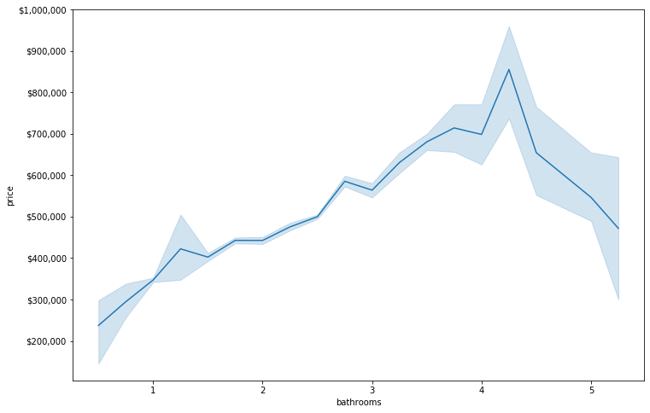
Houses with more bathrooms have higher value on the housing market.
There is a shown trend that houses with more than 4 bathrooms have a lower value.

Slide 11
Square Footage of Living Space
4

Slide 12
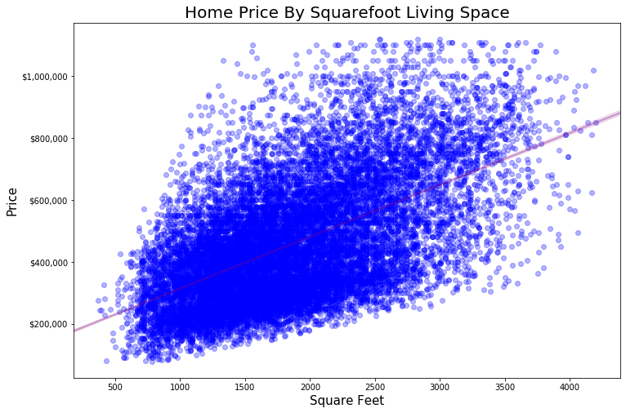
By adding more square footage to a home the value of the house has shown to increase the value of the home

Slide 13
Condition
5

Slide 14
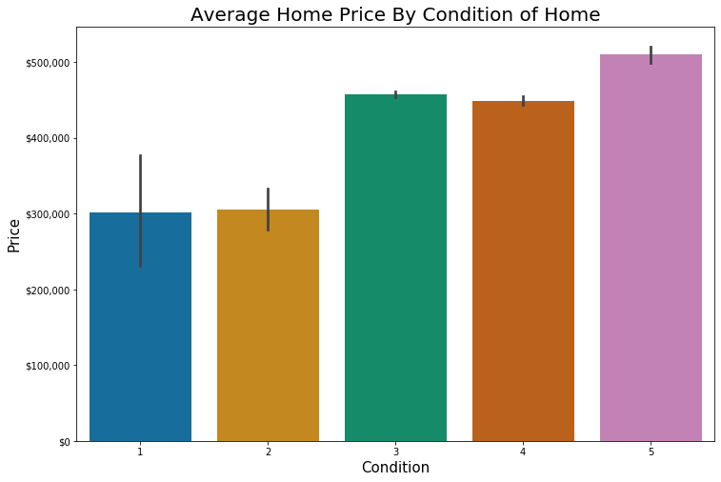
The condition of the home increases the sale price of the home. Homes with condition score of 3 to 5 are the most profitable.

Slide 15
Conclusion
By increasing the “Grade” of the home the home’s value steadily increases
Homes with more bedrooms have a shown higher home value when selling on the market.
Houses with more bathrooms have higher value on the housing market.
By adding more square footage to a home the value of the house has shown to increase the value of the home.
The condition of the home increases the sale price of the home. Homes with condition score of 3 to 5 are the most profitable.

Slide 16
Thanks!

Slide 17
Future Work
Outside features of the home: Does the house have a large/appealing yard?
How are you selling the home?: Selling the home through a realtor or independently
What is the neighborhood? Are there bike lanes? Nearby grocery stores?
Is there a garage or other buildings on the property that would also sell with the house?

Slide 18
Credits
Special thanks to all the people who made and released these awesome resources for free:
Presentation template by SlidesCarnival
Photographs by Unsplash

